Slide 1
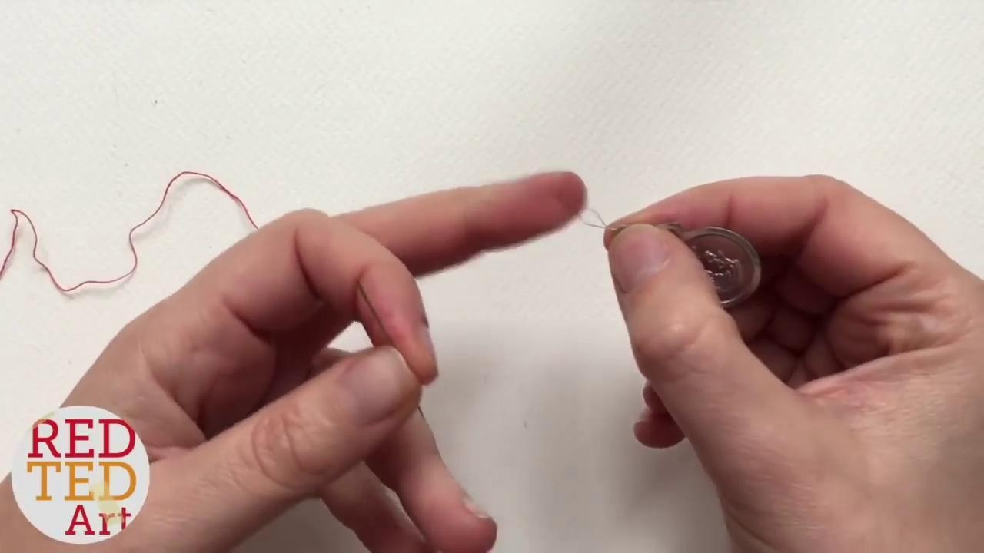
HAND STITCHING LEVELS 1-4
How to thread
How to tie a knot at the start of your sewing
How to end your stitch & tie a knot

Slide 2
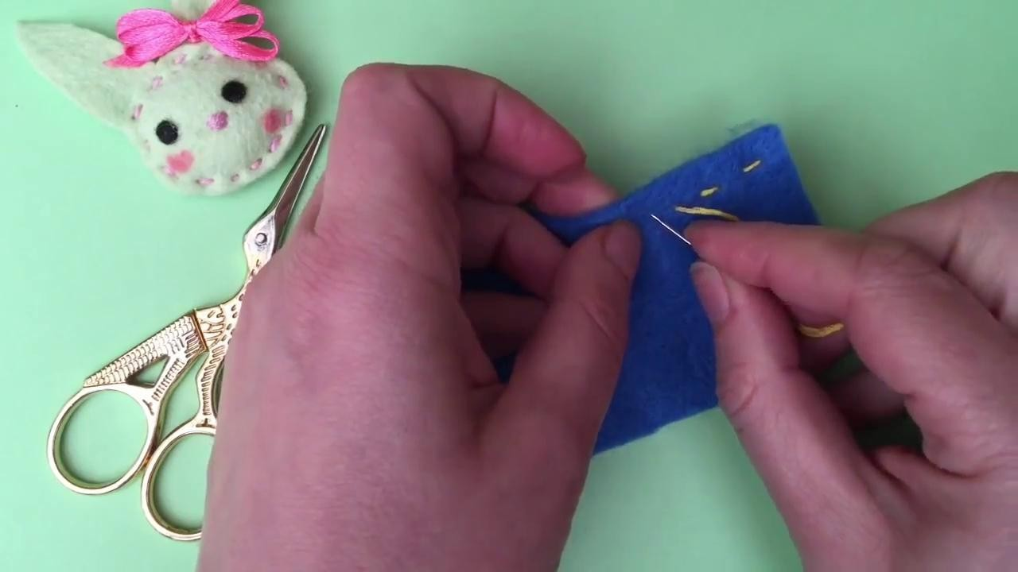
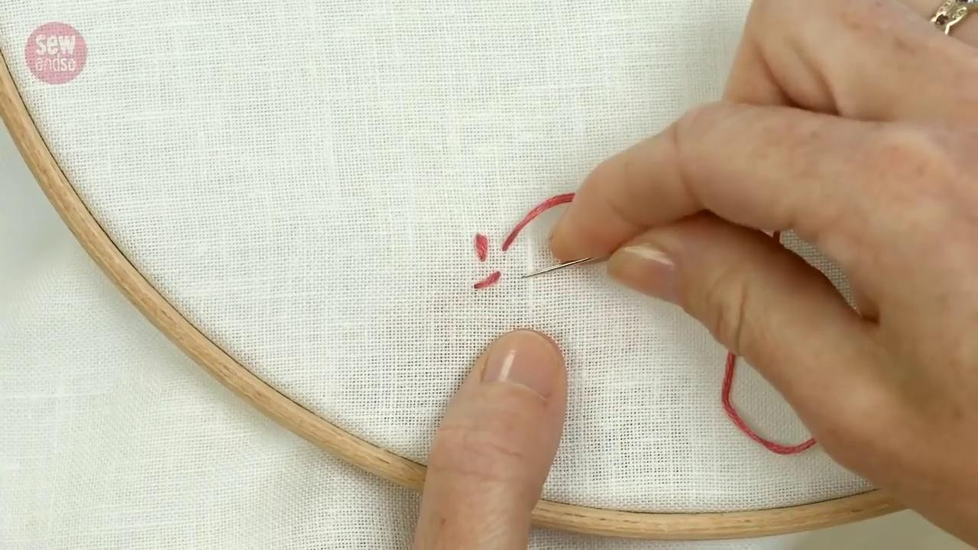
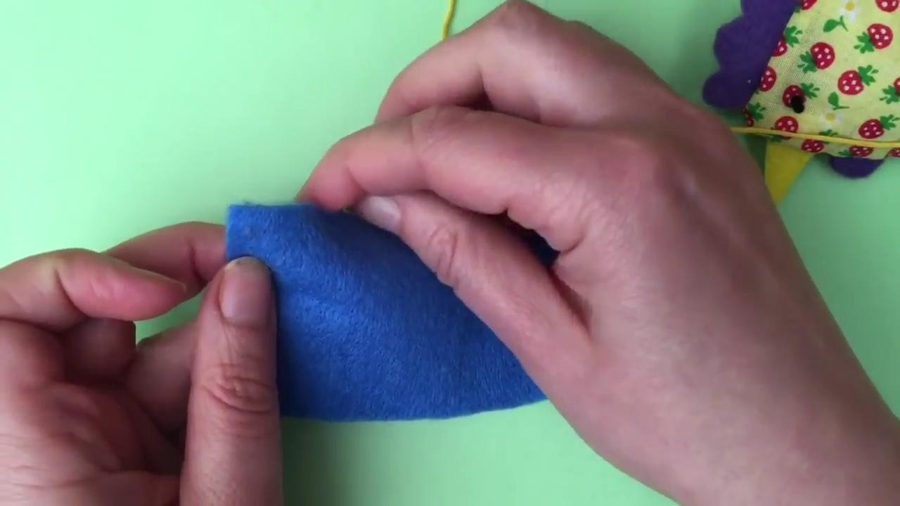
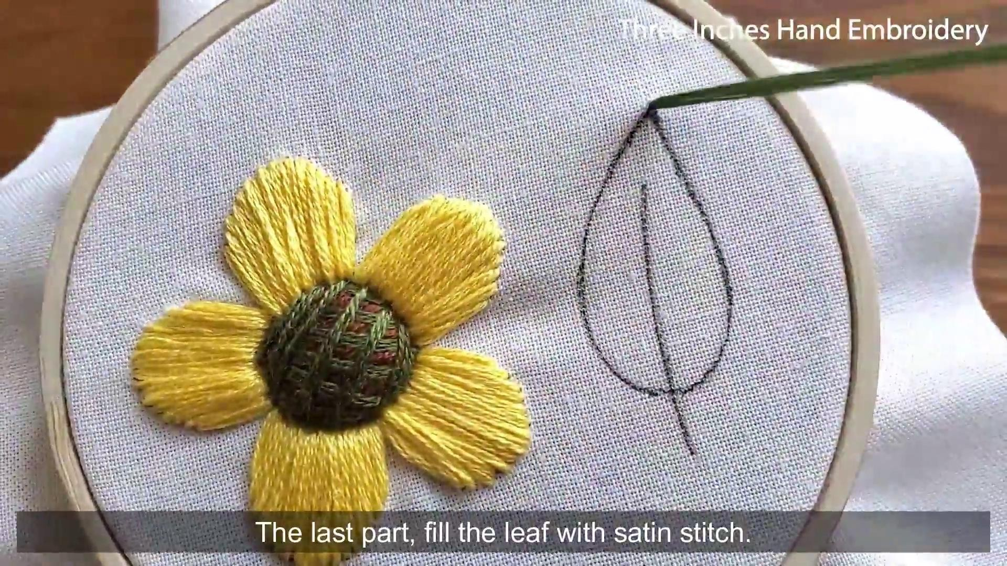
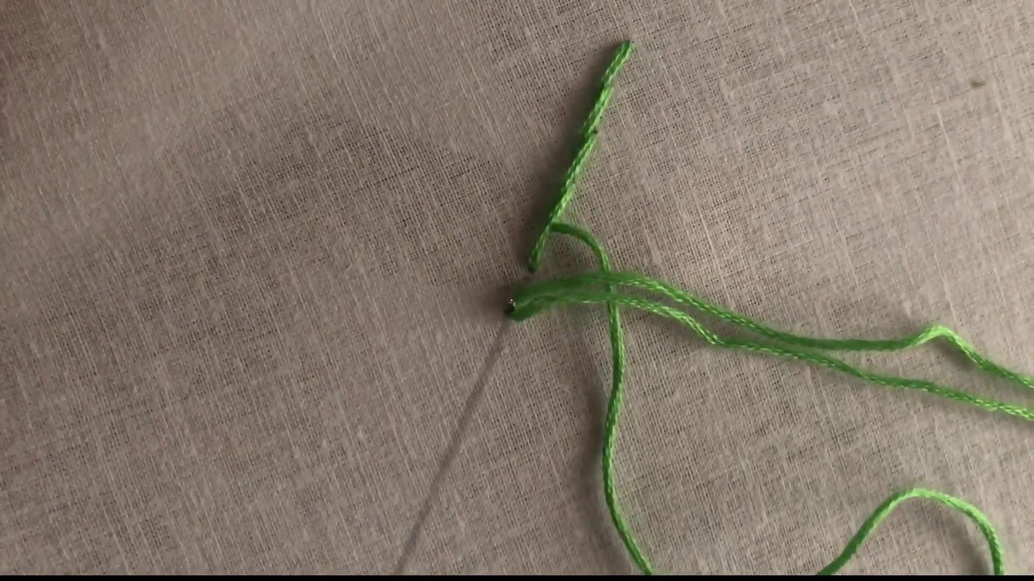
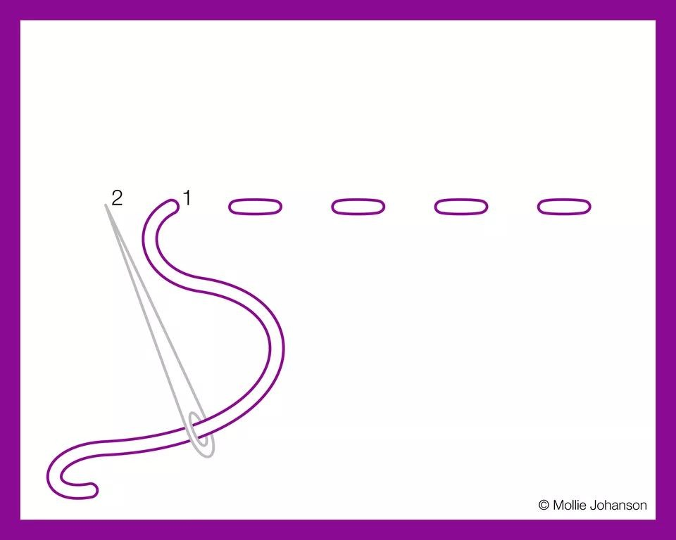
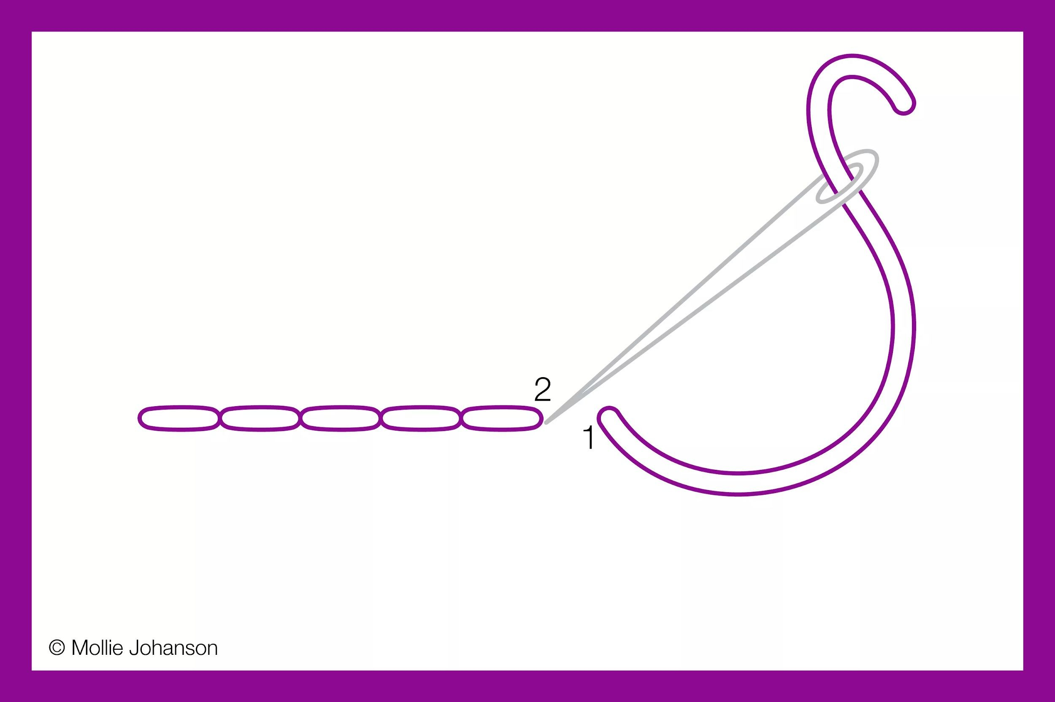
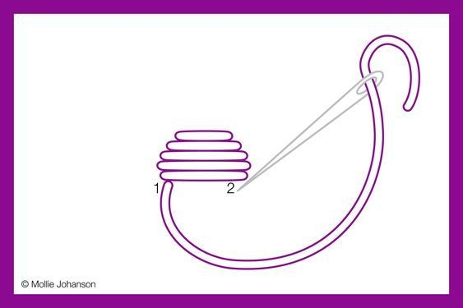
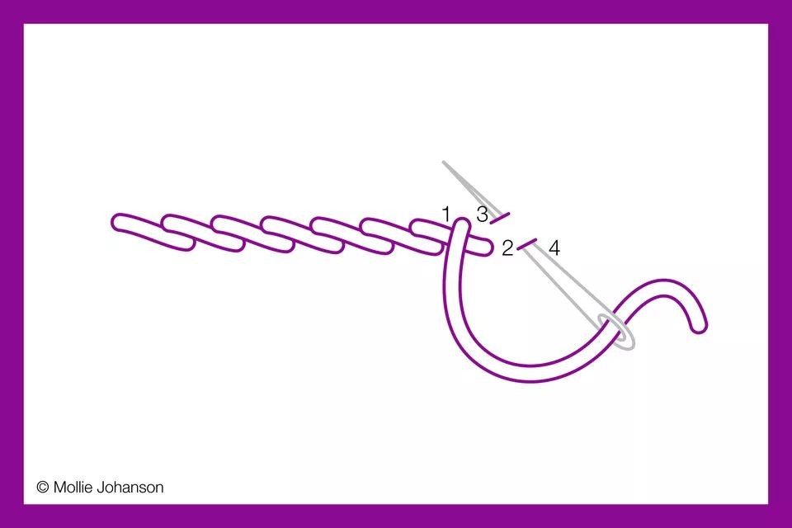
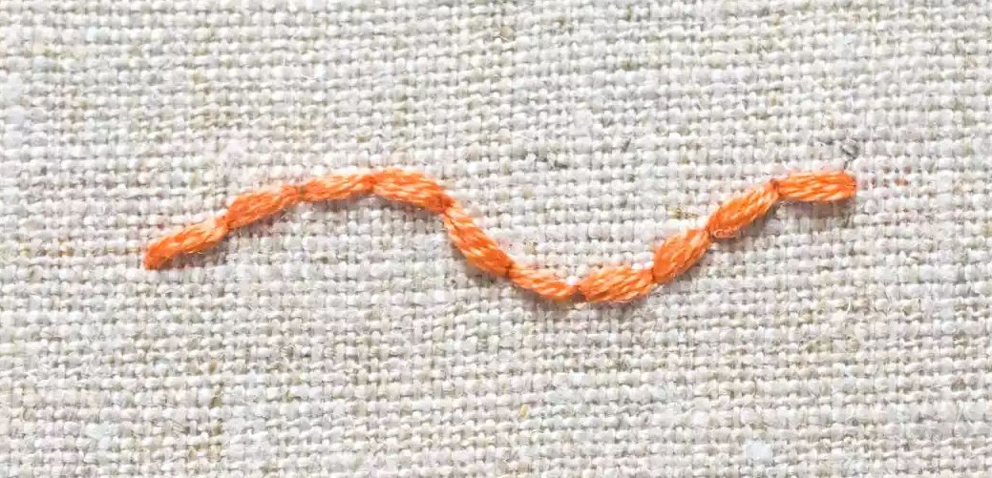
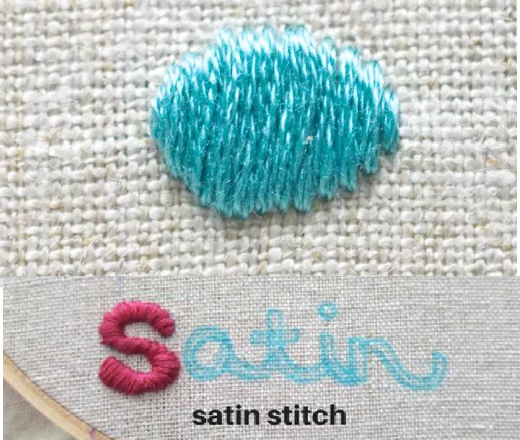
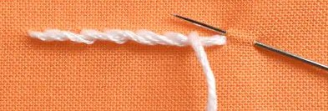
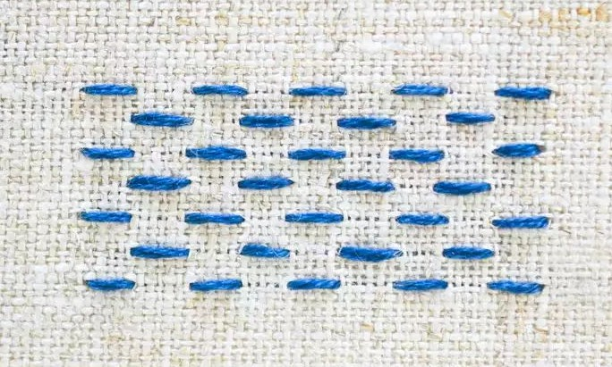
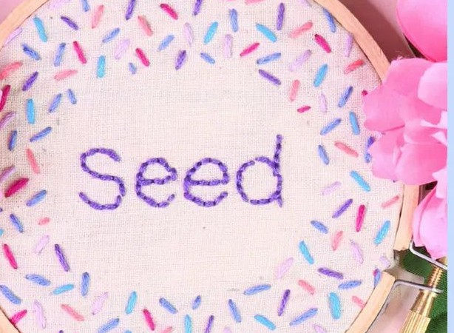
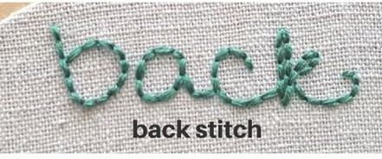
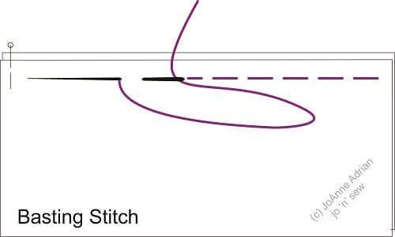
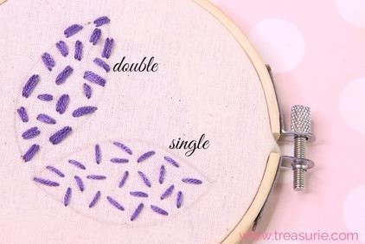
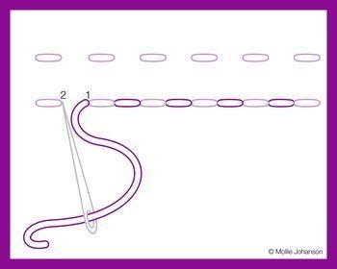
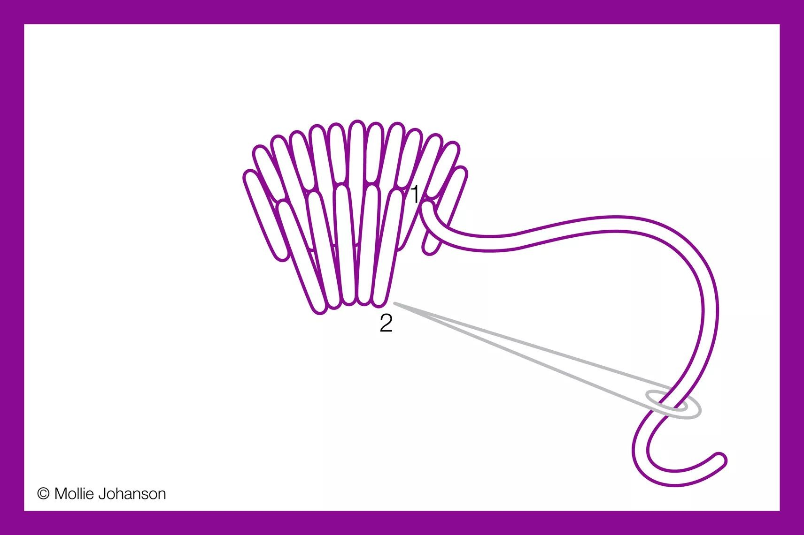
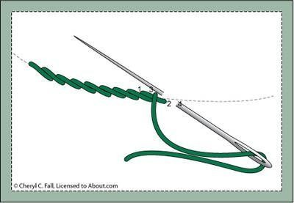
LEVEL 1
LEVEL 1
SEED STITCH
Like running stitches but does not have to be in a
straight line
LEVEL 2
BACK STITCH
Start like a running stitch & then go back
to the original stitch and
continue forward
LEVEL 2
SATIN STITCH
Running stitches very close together
LEVEL 2 OPTIONAL
STEM STITCH
Like the backstitch but this time go back over the first stitch in a slight diagonal and half way
RUNNING STITCH
(Small)
BASTING STITCH
(Large)
EASIER OPTION
Complete running stitch and then go back and fill in the gaps
*you could overlap your stitches to create more height

Slide 3
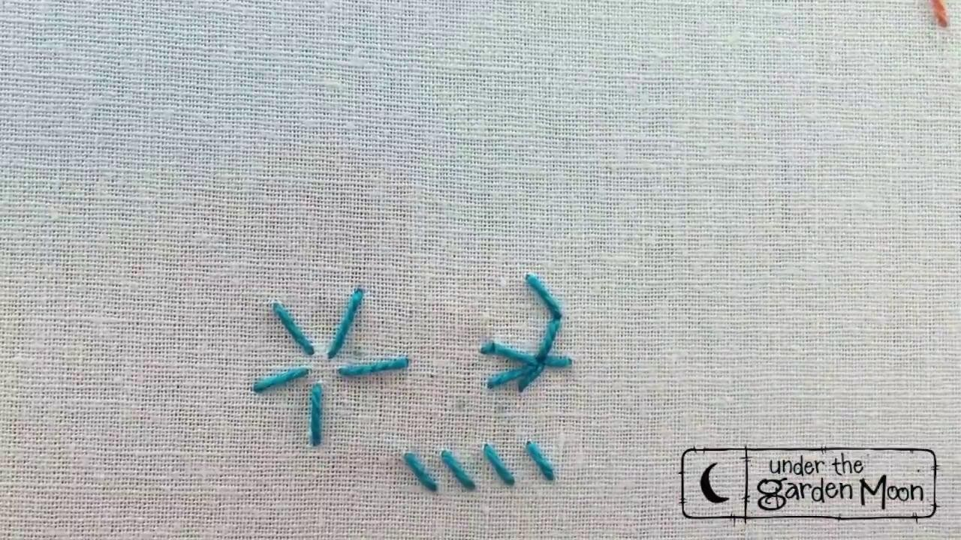
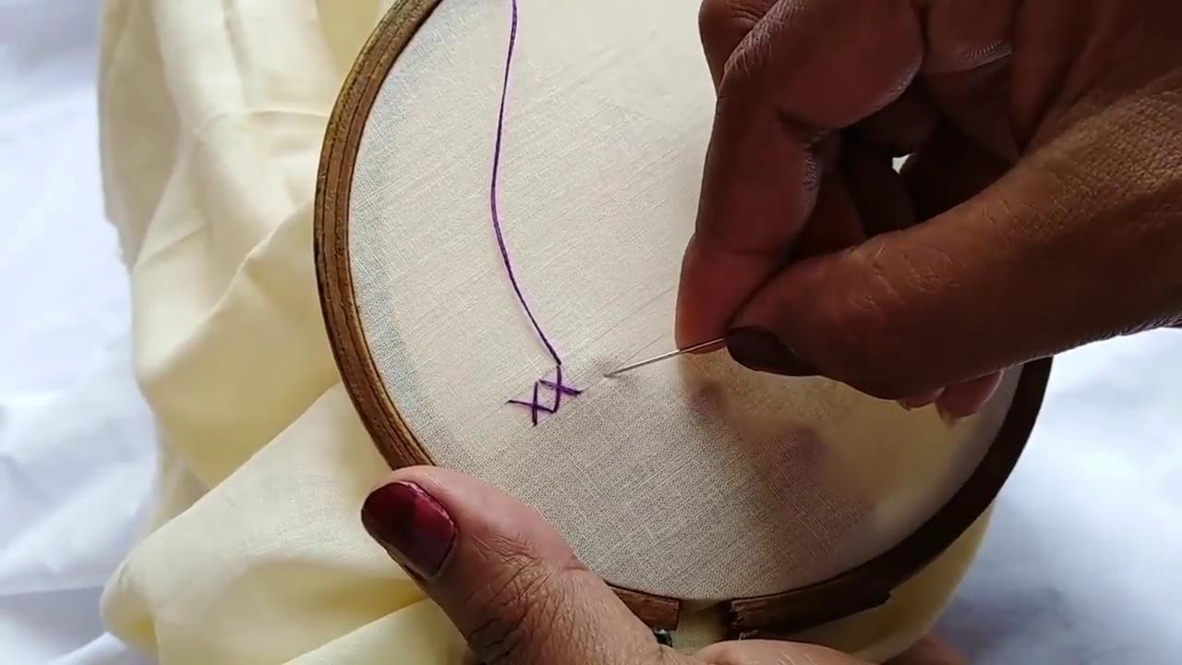
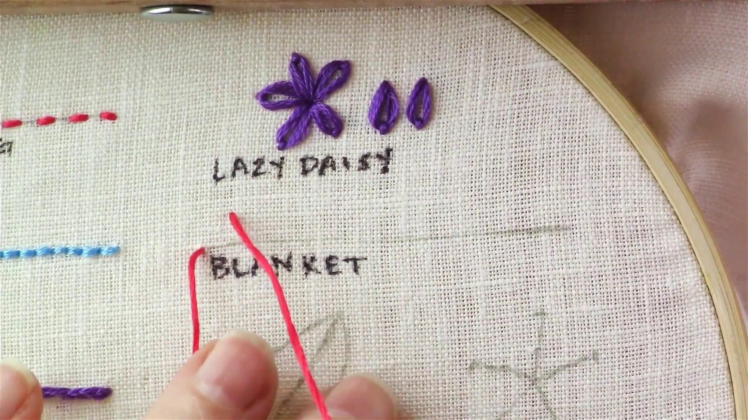
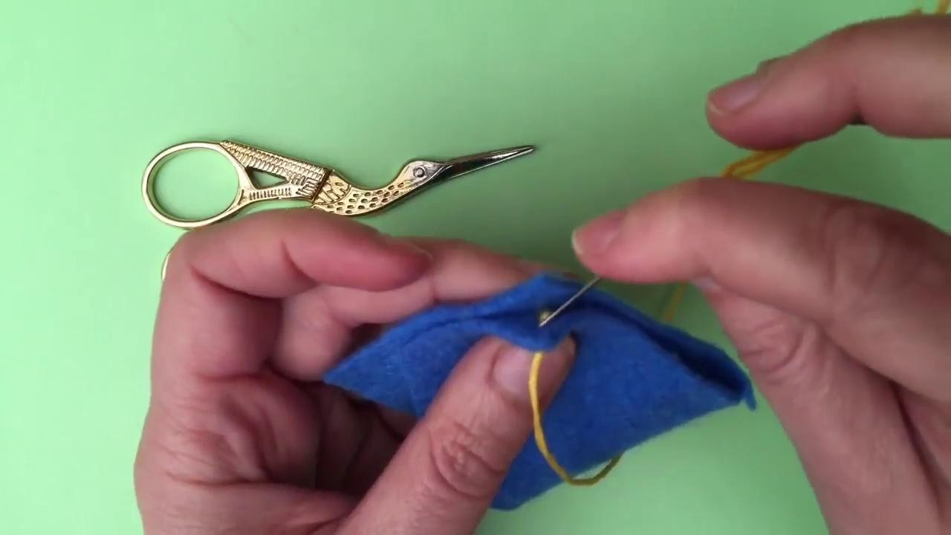
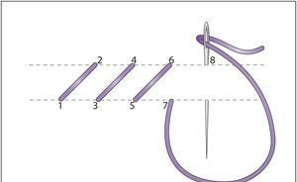
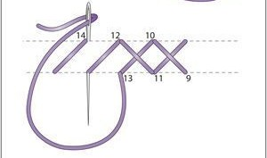
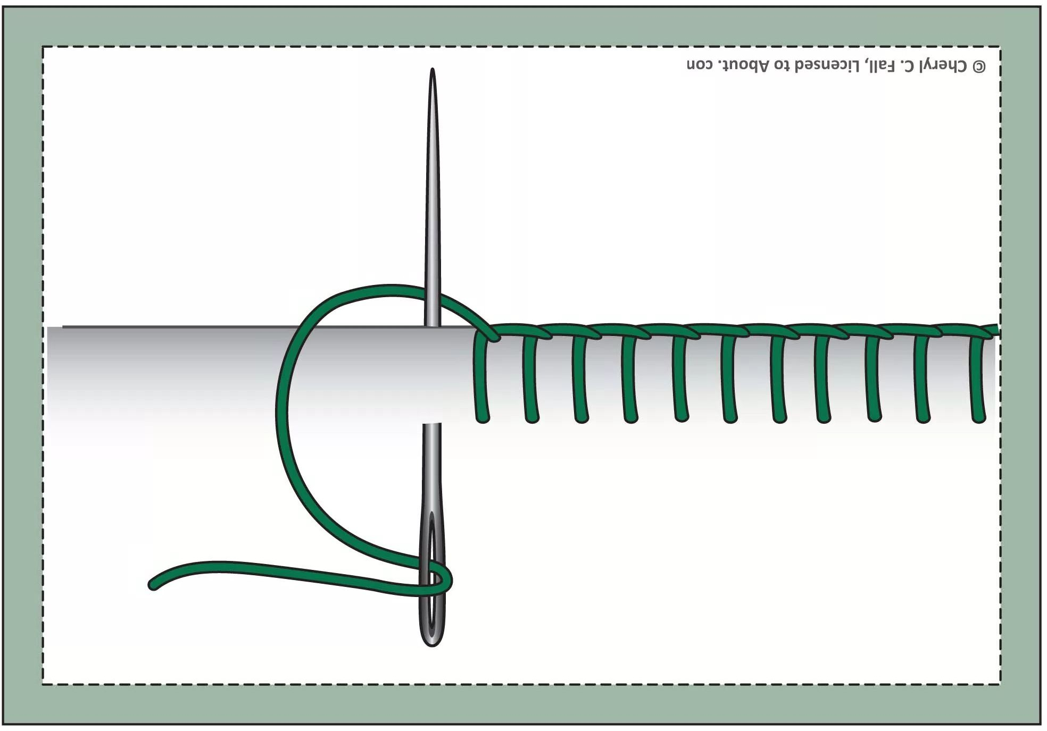
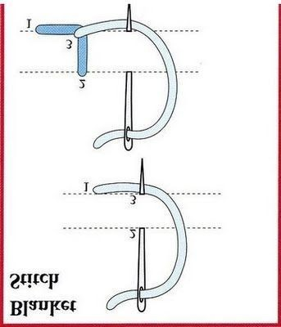
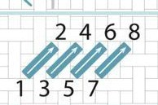
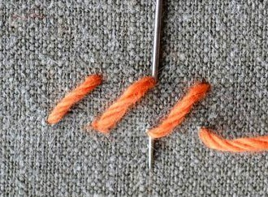
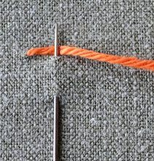
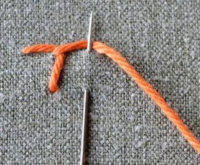
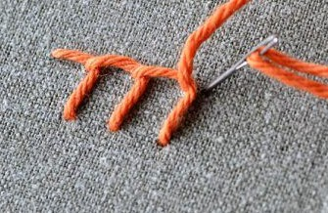
LEVEL 3
LEVEL 3 DIAGONAL/ STRAIGHT STITCH
Needle in (from back to front) Across one,up one-needle in Down one-needle in & REPEAT
LEVEL 3
CROSS STITCH
FOLLOW STEPS FOR DIAGONAL/STRAIGHT
then go back the opposite way crossing over the diagonal
BLANKET STITCH
Needle in (from back to front) Down one , across one -needle in
Up one -needle in BEFORE THE NEEDLE LEAVES THE FABRIC MAKE SURE THE THREAD IS BEHIND THE NEEDLE then PULL THROUGH and REPEAT
Decorative Blanket Stitch Blanket Edging Stitch

Slide 4
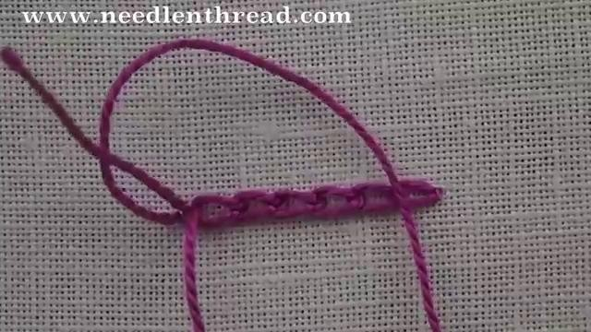
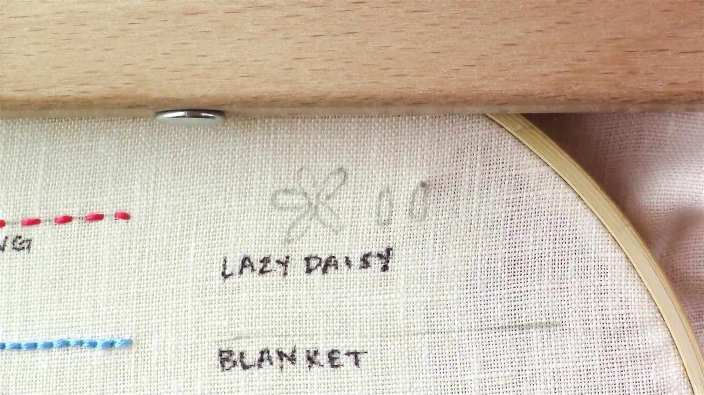
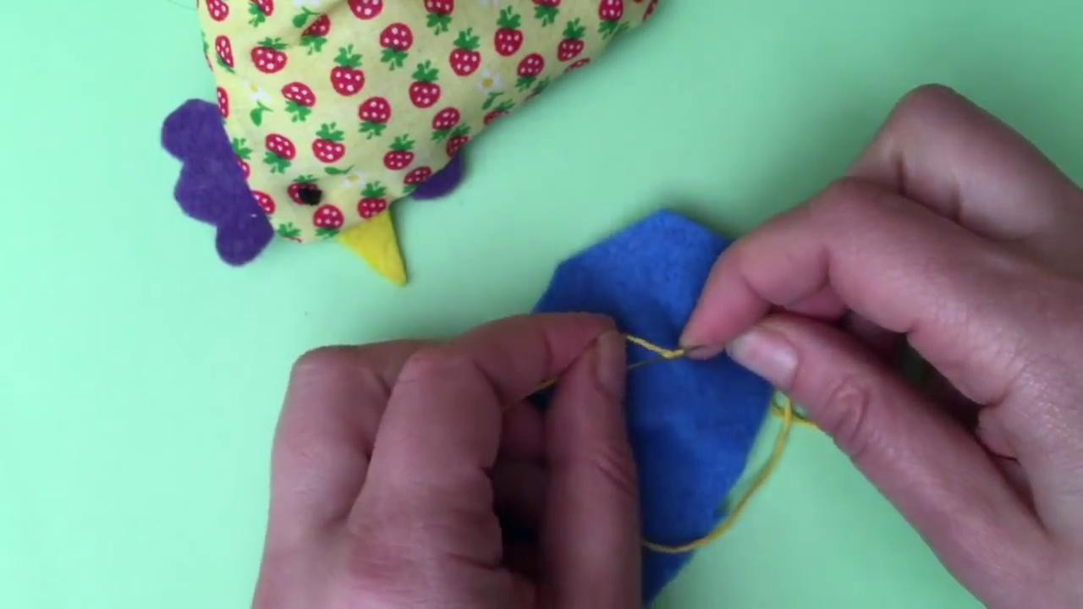
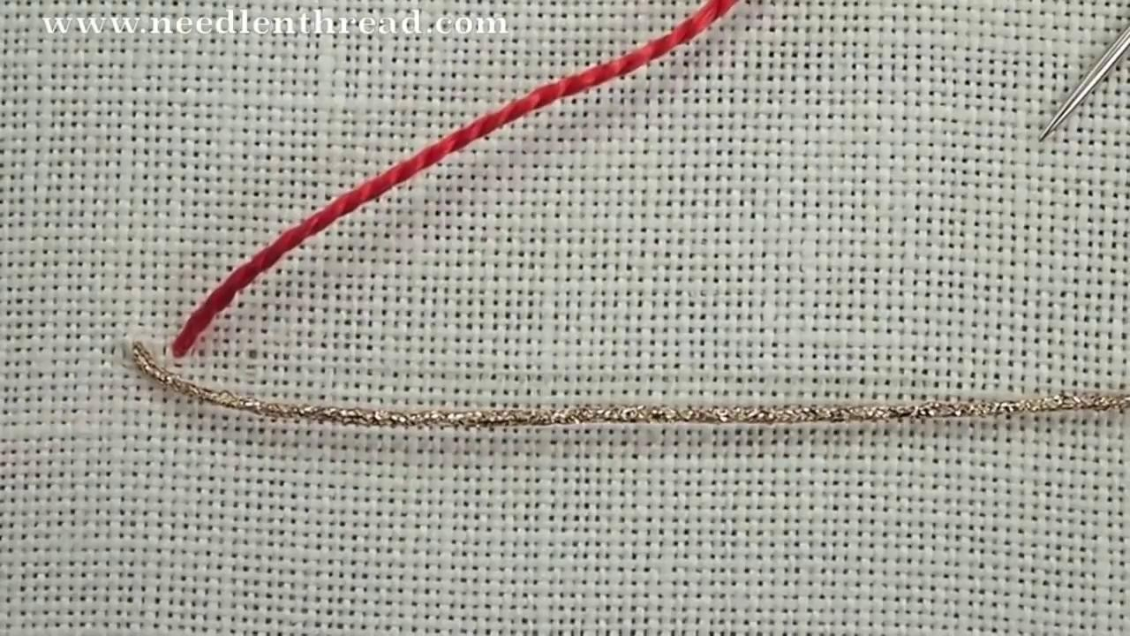
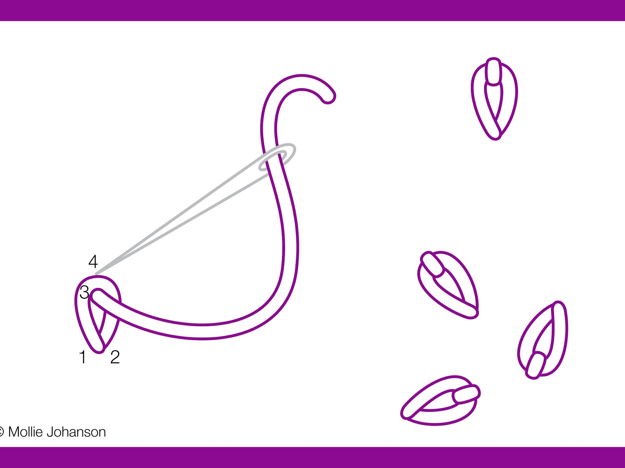
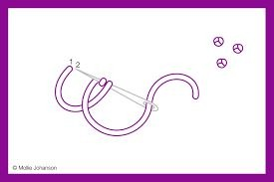
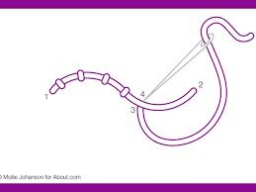
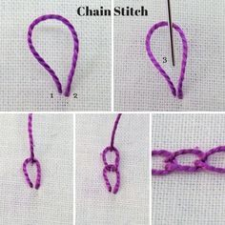
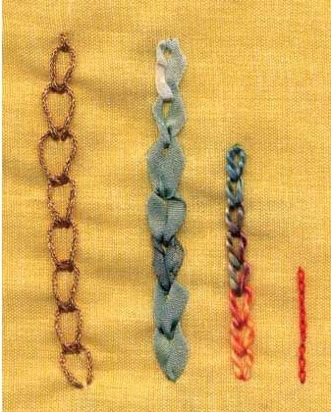
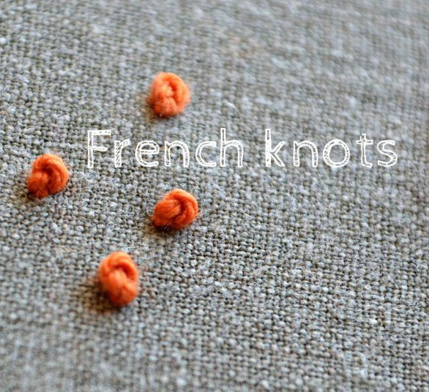
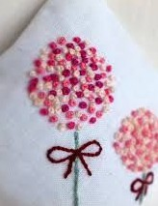
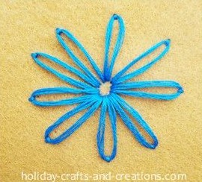
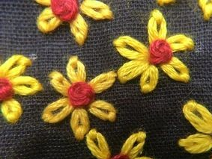
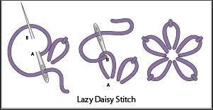
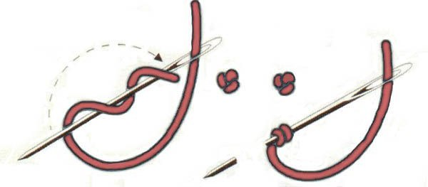
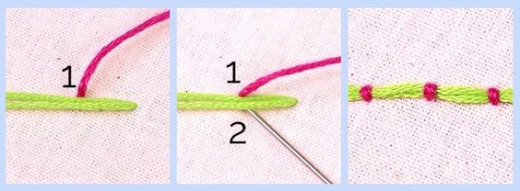
LEVEL 4
LEVEL 4
CHAIN
As you thread through make a loop. Bring the needle from the back of the fabric slightly away from the starting point and then through the Loop and pull gently.
Start again make a loop and carry on
LEVEL 4
FRENCH KNOT
Wrap the thread around the needle 2 or 3 times and then hold the end of thread and then pierce the needle through close to the space where you started from.
LEVEL 4
COUCH STITCH
Thread 1 colour of thread through and leave it as a line loose. Then thread another thread (different colour possibly) close to where you started the other thread & stitch over vertically securing that thread in place, making sure the space is equally spaced out.
LAZY DAISY
Like the chain stitch but you anchor the loop by bringing the thread back down just on the other side of the loop to secure it and the stitch can start anywhere

Slide 5
LEVEL 1
RUNNING STITCH: https://www.youtube.com/watch?v=i1-B01FB56s&t=30s
SEED STITCH: https://www.youtube.com/watch?v=5jBJp1n70IM&list=PLPlygZ9k1etlYarSaTdKKvDJlH61mrN_F&index=44
LEVEL 2
BACK STITCH: https://www.youtube.com/watch?v=sjHm8CL9WDA&t=12s
SATIN STITCHES:
https://www.youtube.com/watch?v=vumRWK6s3Yc&list=PLPlygZ9k1etlYarSaTdKKvDJlH61mrN_F&index=46&t=461s
STEM STITCH https://www.youtube.com/watch?v=2_Q3XUK3-QE&list=PLPlygZ9k1etlYarSaTdKKvDJlH61mrN_F&index=48&t=7s
LEVEL 3
DIAGONAL STITCH
https://www.youtube.com/watch?v=U2cFj3lUtjA&list=PLPlygZ9k1etlYarSaTdKKvDJlH61mrN_F&index=38&t=284s
https://www.youtube.com/watch?v=SBMgbN7huZY
CROSS STITCH: https://www.youtube.com/watch?v=VF9f5zv_CFo&list=PLPlygZ9k1etlYarSaTdKKvDJlH61mrN_F&index=53
BASIC BLANKET STITCH:
https://www.youtube.com/watch?v=S9zegUYdPmg&list=PLPlygZ9k1etlYarSaTdKKvDJlH61mrN_F&index=49&t=18s
DECORATIVE BLANKET STITCH
https://www.youtube.com/watch?v=VgF_x4zLzk0&list=PLPlygZ9k1etlYarSaTdKKvDJlH61mrN_F&index=29
LEVEL 4
CHAIN STITCH: https://www.youtube.com/watch?v=KP3q3H5bnf8&list=PLPlygZ9k1etlYarSaTdKKvDJlH61mrN_F&index=54&t=2s
FRENCH KNOT :https://www.youtube.com/watch?v=dEXSDKPtrs8&list=PLPlygZ9k1etlYarSaTdKKvDJlH61mrN_F&index=55
LAISY DAISY: https://www.youtube.com/watch?v=2pYtAKpRlTM&list=PLPlygZ9k1etlYarSaTdKKvDJlH61mrN_F&index=40
COUCH STITCH: https://www.youtube.com/user/MaryCorbet

